Slide 1

Advance Care Planning (ACP) across the sectors
Metro South Health, Queensland www.mycaremychoices.com.au
Office of Advance Care Planning
Dr Leyton Miller, Registrar, MSH
Xanthe Sansome, Manager, BSPCC

Slide 2

What sectors?
Community
Acute
Residential
Electronic

Slide 3

Which documents?
Advance Health Directive
Enduring Power of Attorney
Statement of Choices

Slide 4
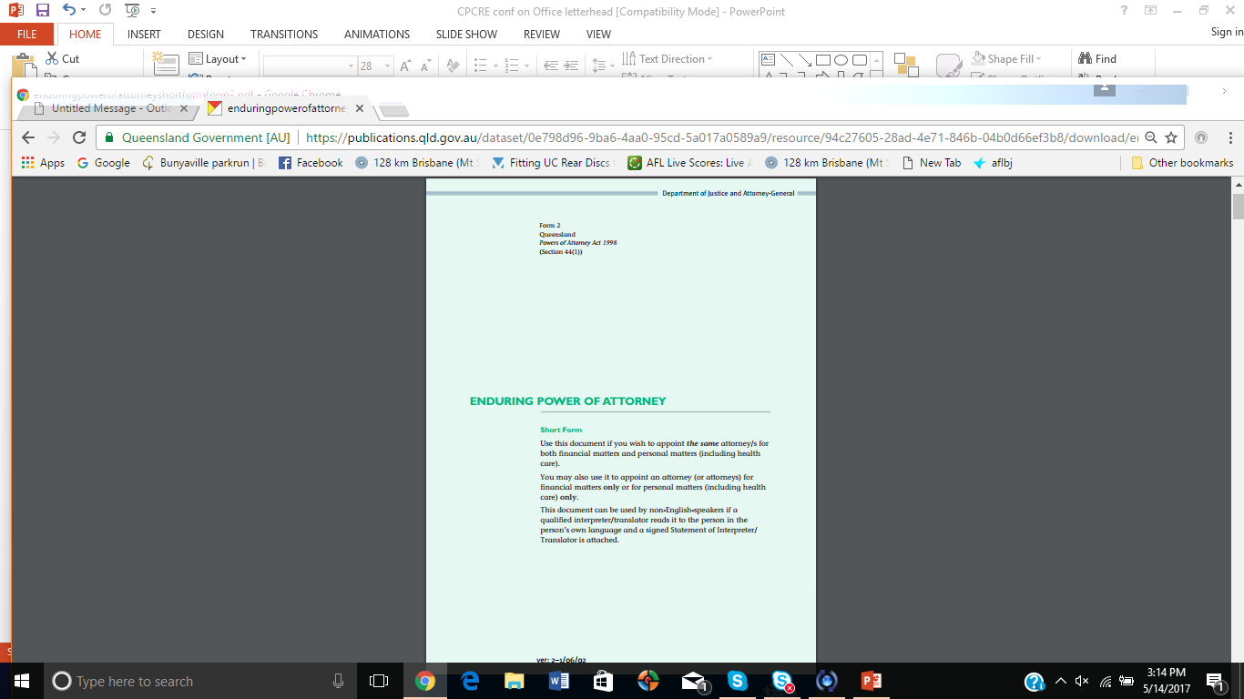
Which documents?
Advance Health Directive
Enduring Power of Attorney
Statement of Choices

Slide 5
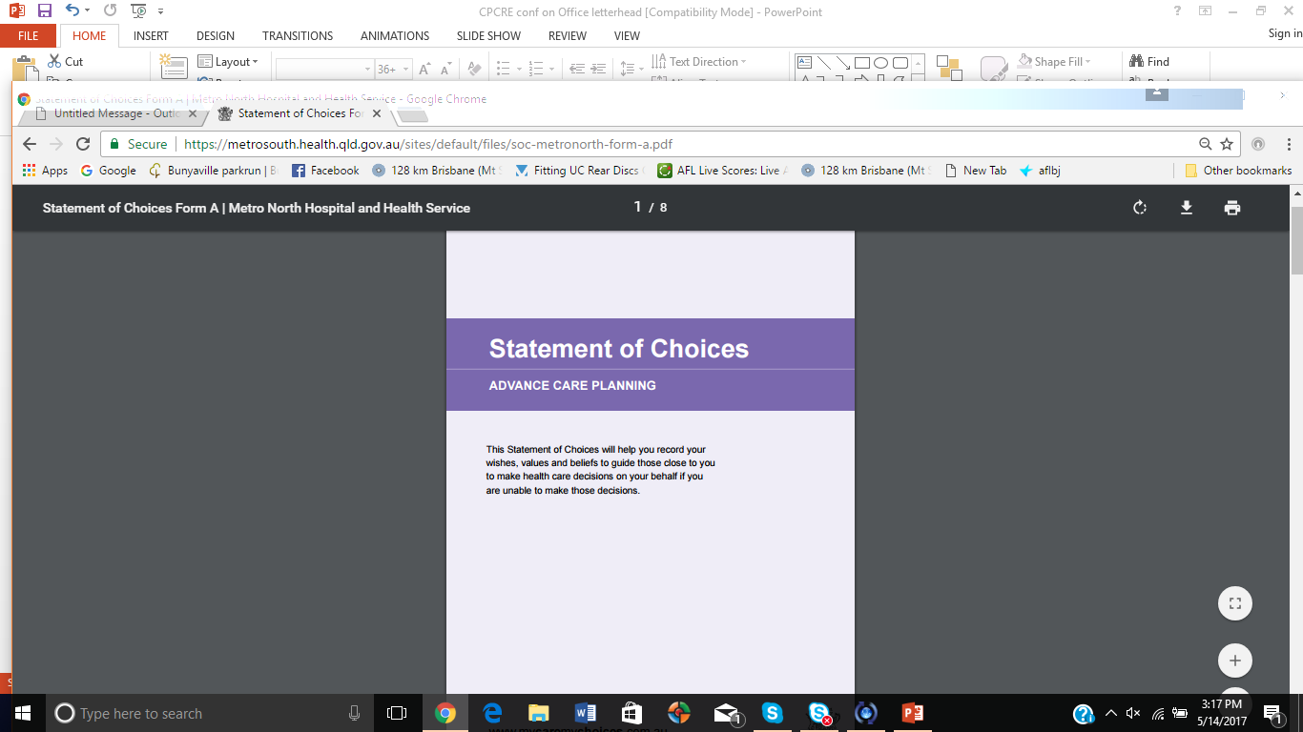
Which documents?
Advance Health Directive
Enduring Power of Attorney
Statement of Choices

Slide 6
Statement of Choices
A values-based document
Not legally binding but does have legal effect
Three pages, in everyday language
Can be completed by person (Form A) or substitute decision maker/s (Form B)
Captures who the person is and what outcomes they want

Slide 7
Statement of Choices
Developed in Feb 2015 by Metro South Health
Currently used by 14/17 HHS in Qld and 4 RACF organisations
Completed documents are sent to Office of ACP to standardise processes
Clinically reviewed and uploaded to The Viewer
Person completing keeps original

Slide 8
Statement of Choices
Accessible by all QH and Mater clinical staff on The Viewer
The Viewer soon to be available to GPs and QAS
Private hospitals can contact the Office of ACP or public hospital ED department

Slide 9

Office of Advance Care Planning
Trialled for 3 months in 2015/16
Funding received for 2016/17
Standardise process and ensure accessibility of ACP documents
Investigating upload of AHDs and EPOAs
in 2017/18
Provide support and information to health professionals and consumers

Slide 10


Office of Advance Care Planning
Key functions of Office of ACP:
Review and upload Statement of Choices documents (from anywhere in Queensland) to The Viewer
Develop a central database of Queenslanders’ end-of-life care preferences to inform future planning of services.
1300 007 ACP
(1300 007 227)
  Email: acp@health.qld.gov.au

Slide 11
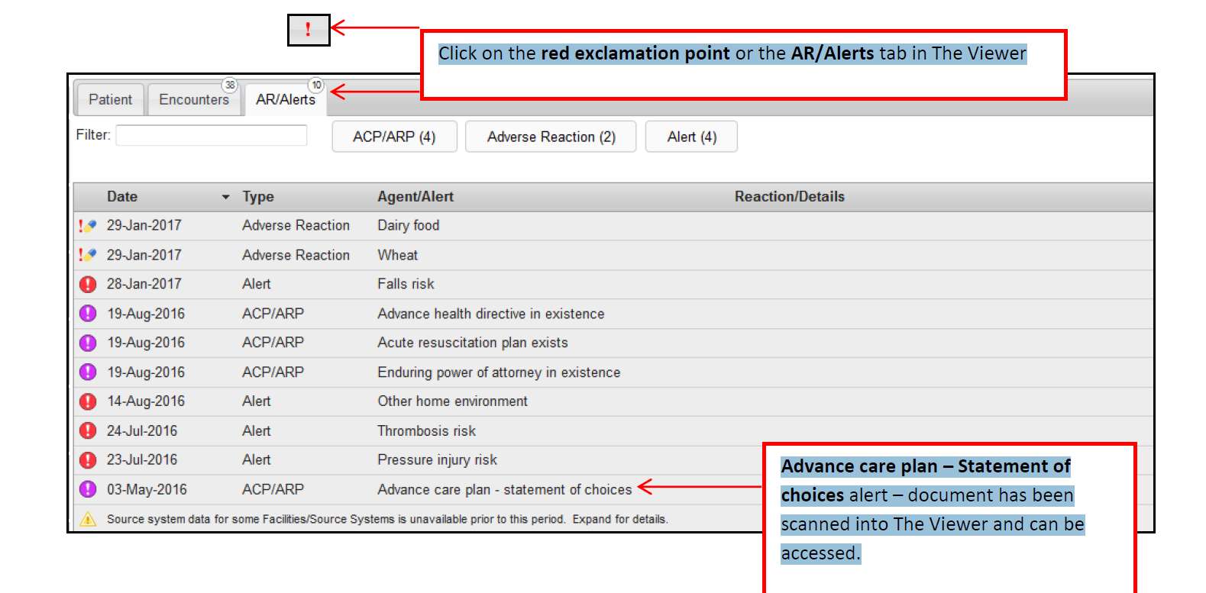
The Viewer

Slide 12
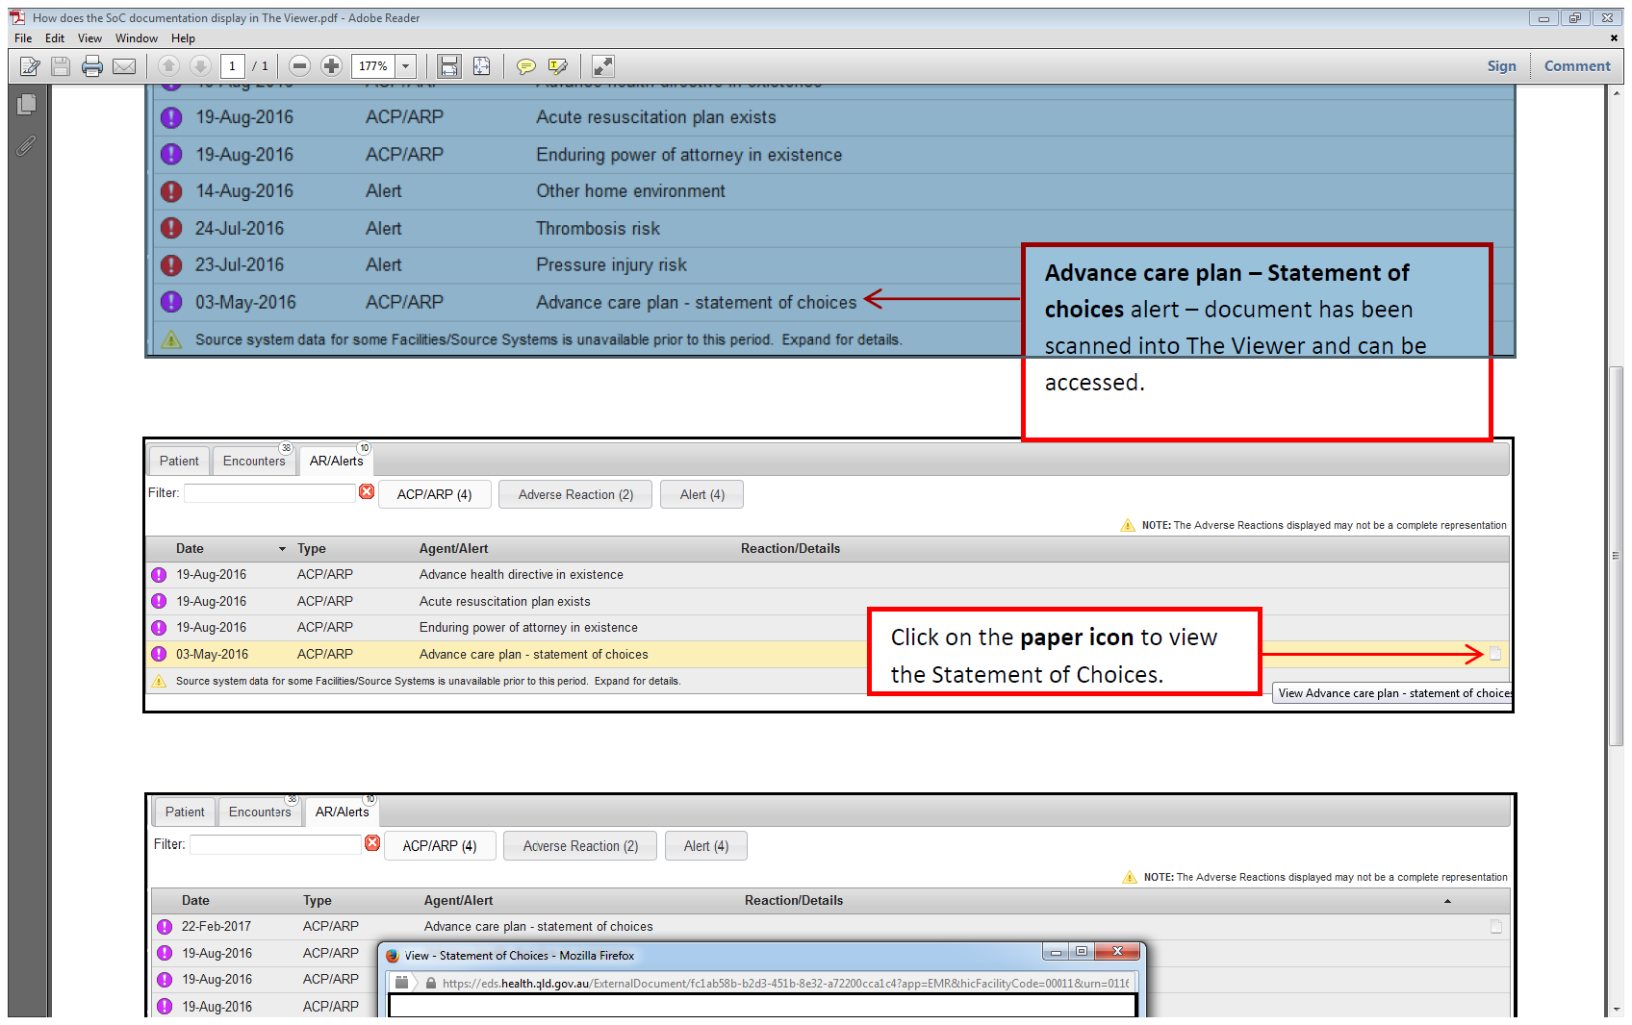
The Viewer

Slide 13
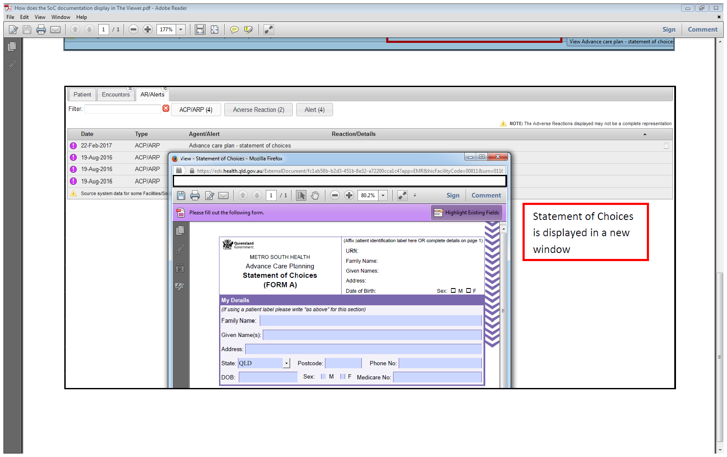
The Viewer

Slide 14
Office of Advance Care Planning
Key functions of Office of ACP:
Review and upload Statement of Choices documents (from anywhere in Queensland) to The Viewer
Develop a central database of Queenslanders’ end-of-life care preferences to inform future planning of services.
1300 007 ACP
(1300 007 227)
  Email: acp@health.qld.gov.au

Slide 15


Slide 16

Statement of Choices (SoC)
As at 30 Mar 2017:
4460 SoCs were uploaded to The Viewer
60% were Form A and 40% were Form B
43% were completed by males
78% had preference for no CPR
81% had preference for no life prolonging treatments

Slide 17
Statement of Choices (SoC)
As at 30 Mar 2017:
4460 SoCs were uploaded to The Viewer
60% were Form A and 40% were Form B
43% were completed by males
78% had preference for no CPR
81% had preference for no life prolonging treatments

Slide 18
Statement of Choices (SoC)
As at 30 Mar 2017:
4460 SoCs were uploaded to The Viewer
60% were Form A and 40% were Form B
43% were completed by males
78% had preference for no CPR
81% had preference for no life prolonging treatments

Slide 19
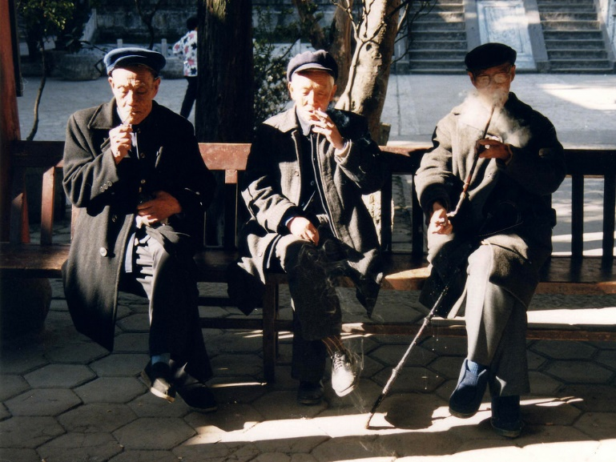
Statement of Choices (SoC)
As at 30 Mar 2017:
4460 SoCs were uploaded to The Viewer
60% were Form A and 40% were Form B
43% were completed by males
78% had preference for no CPR
81% had preference for no life prolonging treatments

Slide 20


Statement of Choices (SoC)
As at 30 Mar 2017:
4460 SoCs were uploaded to The Viewer
60% were Form A and 40% were Form B
43% were completed by males
78% had preference for no CPR
81% had preference for no life prolonging treatments

Slide 21
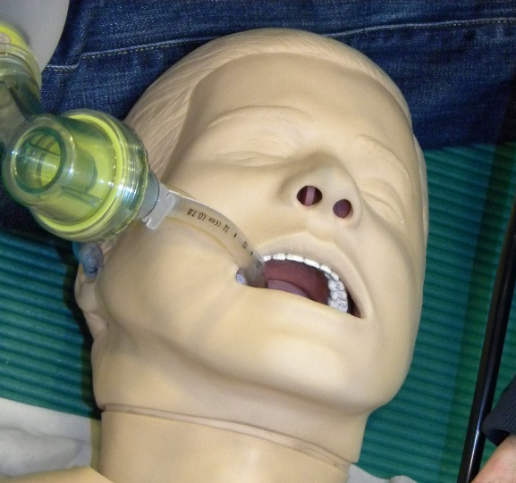
Statement of Choices (SoC)
As at 30 Mar 2017:
4460 SoCs were uploaded to The Viewer
60% were Form A and 40% were Form B
43% were completed by males
78% had preference for no CPR
81% had preference for no life prolonging treatments

Slide 22
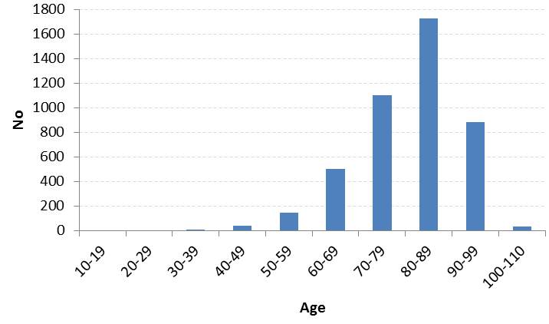
Who are completing SoC documents?

Slide 23
Where are they being completed?
Sector** | 2014/15 | 2015/16 | 2016/17 | Total
Community | 41 | 374 | 537 | 952
Hospital | 195 | 739 | 1118 | 2052
RACF | 89 | 540 | 827 | 1456
Total | 325 | 1653 | 2248 | 4460
**Based on where doctor signed the Statement of Choices document

Slide 24
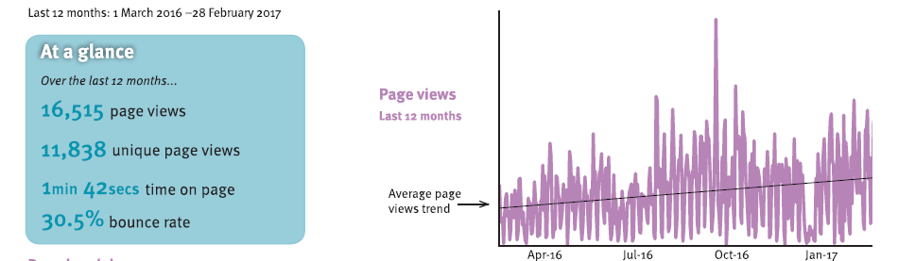
For more information
Visit: mycaremychoices.com.au

Slide 25

Projects
ACP within the acute sector
ACP in RACFs – pilot project
ACP in community
Patient satisfaction with ACP
After death audits

Slide 26

ACP in acute sector
ACP facilitators are:
  Approaching appropriate patients or substitute decision makers (SDMs)
  Educating clinical staff
  Assisting patients/SDMs to complete documents when requested

Slide 27
ACP in acute sector
ACP facilitators are:
  Approaching appropriate patients or substitute decision makers (SDMs) (>10,000 since July 2014)
  Educating clinical staff
  Assisting patients/SDMs to complete documents when requested

Slide 28
ACP in acute sector
ACP facilitators are:
  Approaching appropriate patients or substitute decision makers (SDMs) (>10,000 since July 2014)
  Educating clinical staff
  Assisting patients/SDMs to complete documents when requested

Slide 29
ACP in acute sector
ACP facilitators are:
  Approaching appropriate patients or substitute decision makers (SDMs) (>10,000 since July 2014)
  Educating clinical staff (>1135 staff in 112 inservices)
  Assisting patients/SDMs to complete documents when requested

Slide 30
ACP in acute sector
ACP facilitators are:
  Approaching appropriate patients or substitute decision makers (SDMs) (>10,000 since July 2014)
  Educating clinical staff (>1135 staff in 112 inservices)
  Assisting patients/SDMs to complete documents when requested

Slide 31
ACP in acute sector
ACP facilitators are:
  Approaching appropriate patients or substitute decision makers (SDMs) (>10,000 since July 2014)
  Educating clinical staff (>1135 staff in 112 inservices)
  Assisting patients/SDMs to complete documents when requested (> 3000 Statement of Choices plus EPOAs and AHDs)

Slide 32
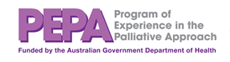
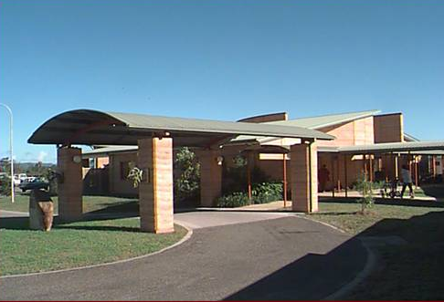
ACP in RACFs
LINK nurse project thanks to
Improving End of Life Care for residential aged care residents

Slide 33


Improving end-of-life care for residential aged care residents
Prof Liz Reymond (project lead)
Dr Karen Cooper (project manager)
Catriona Bisset (CNC)
Joanne Dellit (CN)
Myfanwy Fifoot (admin)

Slide 34
Improving EoL care for residents: National context
Residents should be able to age and die in the RACF^{[1]}
ACP important - residents can state their values, beliefs, preferences for future health care^{[2]}
RACF staff need support to provide high quality person-centred EoL care.
^{[1]} Australian Health Ministers' Advisory Council. A National Framework for Advance Care Directives. 2011.
^{[2]} Detering KM, Hancock AD, Reade MC & Silvester W. The impact of advance care planning on end of life care in elderly patients: Randomised controlled trial. BMJ 2010. 340;1345

Slide 35
Improving EoL care for residents: National context continued
Implementation remains low ^{[3,4]}
Some RACFs are reporting ACP implementation but it is not fully embedded
Suggestion residents’ wishes are not always respected ^{[3]}
^{[3]} Nair B, Kerridge I, Dobson A et al. Advance care planning in residential aged care. Aust NZ J Med 2000. 30:339-343
^{[4]} Detering KM, Hancock AD, Reade MC, Silvester W. The impact of advance care planning on end of life care in elderly patients: randomised controlled trial BMJ 2010. 340:1345

Slide 36
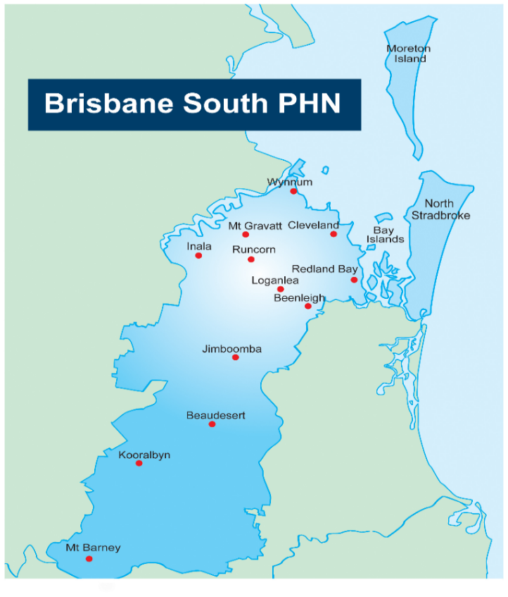
Improving EoL care for residents: BSPHN local context
Geographical area closely matches that of MSH
Includes approximately 90 RACFs, supported by approximately 1,325 GPs
Existing partnerships to support the elderly, their families and healthcare providers including strong links with RACFs and GPs

Slide 37

Improving EoL care for residents: Project aim
To support RACFs to embed an evidence-based
ACP program in their routine clinical care to support high quality end-of-life care for residents and families

Slide 38
Improving EoL care for residents: Key project activities
Education for ACP champions (online, workshop, peer support)
Education for GPs (including locum)
Information sheets for residents, families and/or SDM(s)
An example ACP policy and procedure.

Slide 39
Improving EoL care for residents: Progress
31 RACFs participating
Ethics approval
Identification of ACP champions and GPs by RACFs
Meetings with managers, GPs and ACP champions
Pre-implementation after death audits

Slide 40
Improving EoL care for residents: Multifactorial Progress
Education for 74 ACP champions: 3 online education modules and ½ day workshop
ACP champion education – individualised peer support
GP education – workshops, lunchtime sessions
ACP discussions within RACFs
Managers reviewing policies and procedures

Slide 41
Improving EoL care for residents: Next steps
Satisfaction surveys
Post-implementation after death audits
Evaluation
Dissemination of results

Slide 42


ACP in community
ACP facilitators and registrar are:
  Conducting public presentations to raise awareness of ACP
  Providing GP education when requested

Slide 43
ACP in community
ACP facilitators and registrar are:
  Conducting public presentations to raise awareness of ACP (>6800 attendees at 227 presentations)
  Providing GP education when requested

Slide 44
ACP in community
ACP facilitators and registrar are:
  Conducting public presentations to raise awareness of ACP (>6800 attendees at 227 presentations)
  Providing GP education when requested

Slide 45


Patient satisfaction
Ethics approval
Consenting patients in hospital
Surveying participants as to satisfaction with discussion and feedback on SoC
Evaluation pending

Slide 46

After death audits
Ethics approval
Waiver of consent
Evidence of ACP
Congruence with SoC and end-of-life care received

Slide 47

Moving forward

