Slide 1

Connecting bereavement support practitioners to reliable research evidence
Sarah Hayman, Research Fellow (Evidence)
Jennifer Tieman, CareSearch Director
Associate Professor, Palliative and Supportive Services, Flinders University
Australian Grief and Bereavement Conference, March, 2014
Notes:
Thank you for the opportunity to talk to you today at this very important conference about the services we provide at CareSearch to help provide access to evidence for all of you who work in this field of grief and bereavement. We want to make it easier for you to find the evidence you need, allowing more time for the very important clinical work that we are hearing about at the conference.

Slide 2
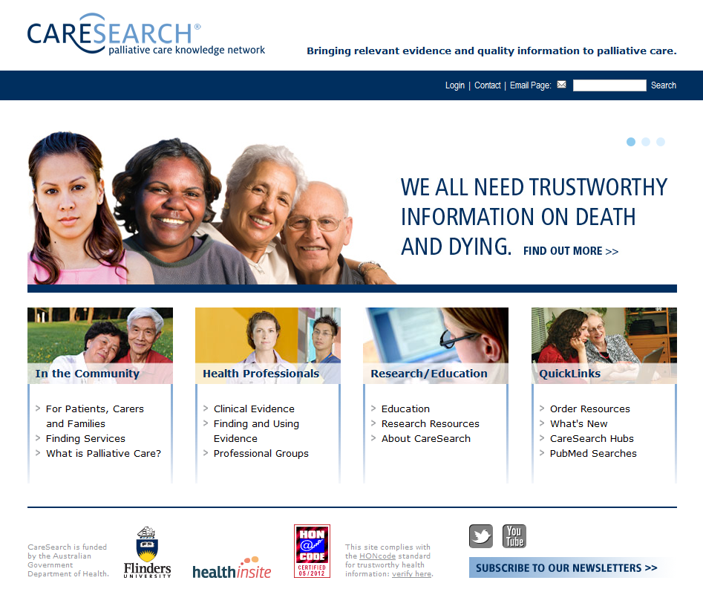
Notes:
A bit of background first about CareSearch. This is the CareSearch front page. CareSearch is funded by the Australian Government 's Department of Health to be an online resource designed to help all those needing relevant and trustworthy information and resources about palliative care.
This includes all groups of users as you can see on the site: community, professionals, researchers
CareSearch is free and it is easy to access – no logon required to search and access the information
Our focus today is the Health Professionals area of CareSearch – specifically the Clinical Evidence and within that Patient Management. This is the area where there is a special focus on bereavement grief and where the Bereavement Search Filter can be found.
CareSearch places enormous importance on high quality evidence – this approach underpins the information and resources we provide. We follow a knowledge to action model developed by the Canadian Institutes of Health Research in the way the site is designed as well as the evidence-based approach to practice that we promote. This model includes a Knowledge Inquiry step which encompasses the search for evidence – what we call “Finding and using evidence” on the site.
The emphasis on quality evidence is a point of difference about CareSearch in comparison to some other websites that offer health information. Note the Honcode icon on the front page. This signifies in essence that information on the site can be trusted. More details are available about this if you are interested – just click on the icon.

Slide 3


Information needs for bereavement practitioners
Diffuse environment
Small teams or sole practitioners
Lack of ready access to databases and journals
Notes:
Practitioners in the bereavement field, like other health practitioners, need reliable evidence to support their practice. This is a growing imperative in all areas of health care, and indeed in professions beyond health.
However, this is a diffuse environment; bereavement care is provided by a wide range of people in many different settings. Bereavement professionals often work in very small teams or alone. They may not have the benefit of working in a large organisation such as a government department or hospital, or a university, where they would have access to expensive databases to search in, and subscriptions to commercially published journals.
In response to these needs, CareSearch has created a new search filter for bereavement care. This will assist clinicians to find information in this key area.

Slide 4

Research, Evidence, Literature
Research
  Understanding, efficacy, implementation
Evidence Use
  Individual in clinical decision making
  Service/Organisation for guidance
  System for policy directions
Published Literature
  Key mechanism by which
  research is made available
Notes:
Here we focus on three key elements within evidence-based practice and how they inter-relate.
These three elements are significant for evidence-based practice: how clinicians can translate knowledge into practice and improve outcomes for patients.
Research provides an understanding of a care issue and can create knowledge of the efficacy of particular approaches – do they work, how well do they work? It can also provide information about how to implement care approaches.
Evidence, provided by the research, is used by different people and groups in different ways. It can be used by individuals in decision making about their own clinical practice – direct treatment and care of individual patients.
It can be used by services and organizations, such as aged care homes, hospitals, clinics, community centers to guide decisions at a service or organisational level.
And it can be used at a system level to inform policy about health care. We have a forthcoming federal budget where decisions will be made about resourcing programs; we would certainly hope that these decisions would be informed by research and be evidence-based.
Published literature is the main source of this evidence.

Slide 5
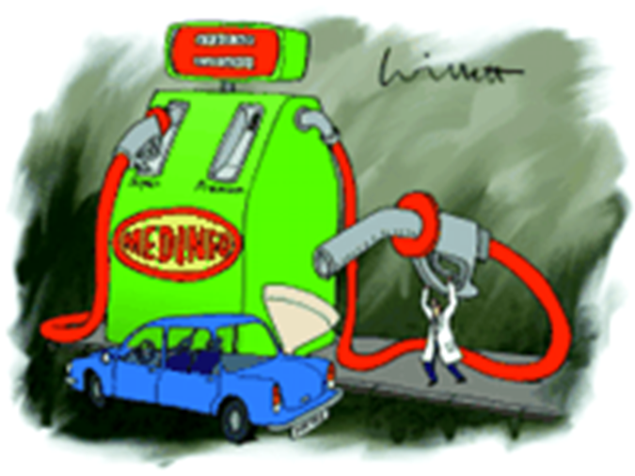
Why evidence matters
Informs direct care
Guides decision making
(policy and service)
Helps assess value or options
Provides a basis to disagree
Notes:
An overview of why evidence matters and how it can be used:
As we’ve said it informs direct care and can guide decision making at policy and service levels as well as the individual patient level.
It can also help assess the value of a particular approach (again at individual or service or system level)
And it can help you decide between options if you are weighing up one against another – evidence can help you decide which is best.
And it can be important in providing a basis to disagree with a decision which has been put forward - if you want to recommend another course of action it is important to have evidence to back up what you are saying.

Slide 6
Challenges in finding literature
Search enables information retrieval
Challenges in information retrieval
  Information overload
  Published?
  In a bibliographic database?
  Indexed, thesaurus?
  Rights to access?
  Specific interface
  Skills of searcher
Notes:
So we know that is important to find this evidence and that it is going to be found in published literature – but there are many challenges in finding it.
Search makes information retrieval possible but there are challenges
As of 19 May 2013, PubMed has over 22.7 million records; about 500,000 new records are added each year
Every day there are now 11 systematic reviews and 75 trials published (2010 estimate).
Is it published – how to find out?
Is it in a bibliographic database or on the web?
Is it indexed (that is, has someone classified and organised it, giving it medical subject headings? If so, was a thesaurus used and what terms were used?)
Do you have the rights to access it? May require a paid subscription.
Different databases have different interfaces, different ways in which they expect you to enter your search query. Time consuming and difficult to learn them all.
Good searching requires a high level of skills, knowing how to interact with the databases, whether to truncate terms, how to combine terms, etc. Can be a big challenge.

Slide 7
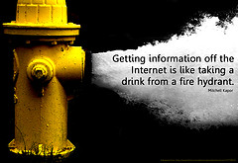
Easy to find?
http://www.flickr.com/photos/25031050@N06/3292307605
Characteristics of ideal search:
Open access (no registration)
Pre written (easy)
One click (fast)
Retrieves what we need and excludes what we don’t (accurate)
/
Notes:
We all know what it is like trying to find information on the internet. Ideally, what we would like is a search that does all of these things.

Slide 8
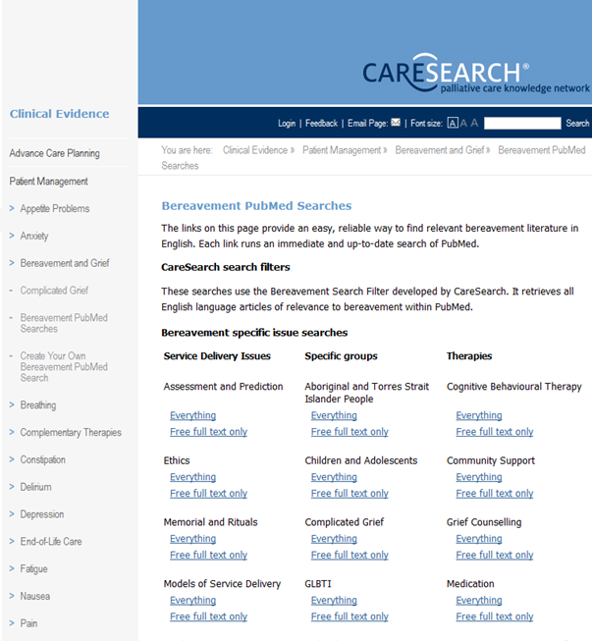
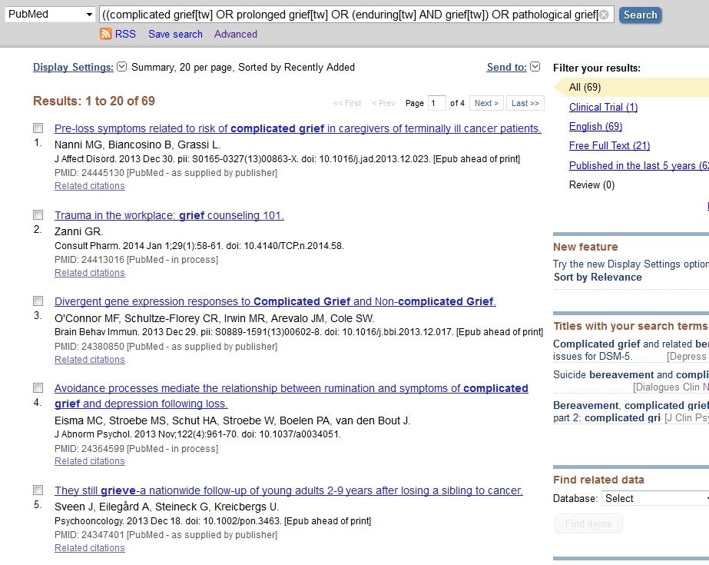
From this …
… to this
- with simple clicks
Notes:
We believe we can come closer to this ideal using a search filter which accesses the PubMed database. It is open access, easy, fast, accurate.
It is also free and trustworthy. The latest international evidence available through the PubMed database becomes readily accessible.
This slide shows our use of the bereavement search filter provided on the CareSearch website as the basis for searches on specific topics.
It is found under Clinical evidence > Patient Management > Grief and bereavement > Bereavement Pubmed searches A simple click on a link takes you to results from a real-time and current search in Pubmed.
This is a recent (February) search activated by clicking on Complicated Grief and choosing to see the Everything option.

Slide 9

PubMed
Why PubMed?
  Open access
  Free to use
  Hyperlinking
  (Able to create URLs)
  Non indexed set
  Choice of full text only

Slide 10

Why use a search filter?
An “evidence based" search
= known effectiveness
Benefits
  Saves time
  Increases likelihood of quality retrievals
  Removes individual search burden
  Embeds technical expertise
  Facilitates knowledge translation
Notes:
To summarise, these are the benefits a search filter can provide

Slide 11
Search Filter Methodology
Scoping Study
Expert Advisory Group
Gold Standard Selection
Term Identification
Search Filter
Post Hoc Relevance Assessment
PubMed Translation
Notes:
Won’t go into detail but will just outline the rigorous, tested and published methodology used to create the search filters at CareSearch. There is input from the expert advisory group throughout the process to minimise bias and ensure that the filter will be of clinical relevance when it is created.

Slide 12
Bereavement Search Filter
Project Overview
  Partners: external advisory group
  Part of CareSearch 2011-14 work program
Performance
  Recall in FVS: 81.16%
  Post hoc relevance: 72.4%
Notes:
The Bereavement Search Filter was created during 2013 and launched in November.
The FVS is a filter validation set used during the process to test how well the filter retrieves items of known relevance.
The Post hoc relevance, using the expert advisory group, tests how well the filter retrieves only relevant items (that is, none that are irrelevant).
In most cases, dialling up the sensitivity , that is aiming to retrieve everything relevant, increases the number of irrelevant items also pulled in, so we aim to achieve a balance of both.
The advice of the expert advisory group in the Bereavement search filter project was that they believed the most clinically useful references would be focussed on bereavement defined as the loss of a loved one, rather than general literature on grief in all contexts (eg loss of a pet, marriage etc). Technical challenge because of the indexing terms used by the national Library of medicine.

Slide 13
Some technical challenges
  Concept boundaries: Bereavement and Grief
  Indicators of the difficulty of searching in this field
  Solution: two search filters
  Implications for the palliative care search filter

Slide 14
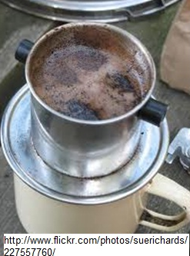
The filter in action …
Notes:
So let’s see the filters in action.
It can be useful to have the image of the coffee filter in mind as an analogy for search filters. They are designed to keep out what we don't want (the coffee grounds) and let through what we do want, the coffee itself.

Slide 15
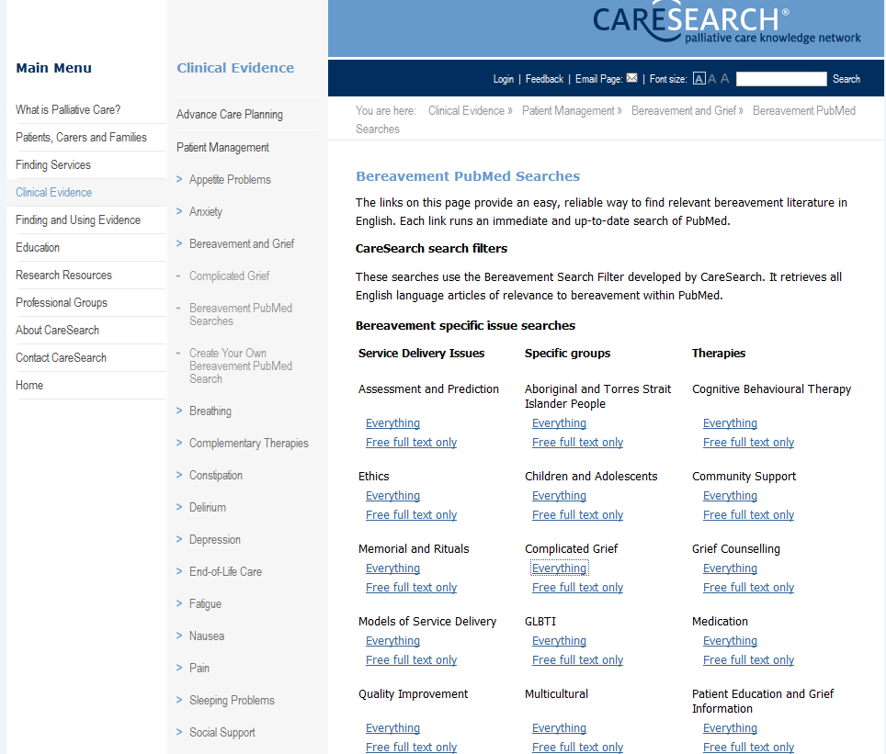

Notes:
The Bereavement search filter is housed within the Patient management section of the Clinical Evidence section of the CareSearch website.
You can bookmark and/or share this link to go straight to it.
The filter has been used to create a set of Bereavement PubMed Searches.
The Expert Advisory Group provided advice on clinically useful topics for searches and suggested how they might usefully be grouped. We have clustered them into 3 different topic categories, as shown here. There are 21 in all.
We will demonstrate clicking on the everything link under Multicultural. This takes us to references in PubMed about bereavement care and a multicultural context.

Slide 16
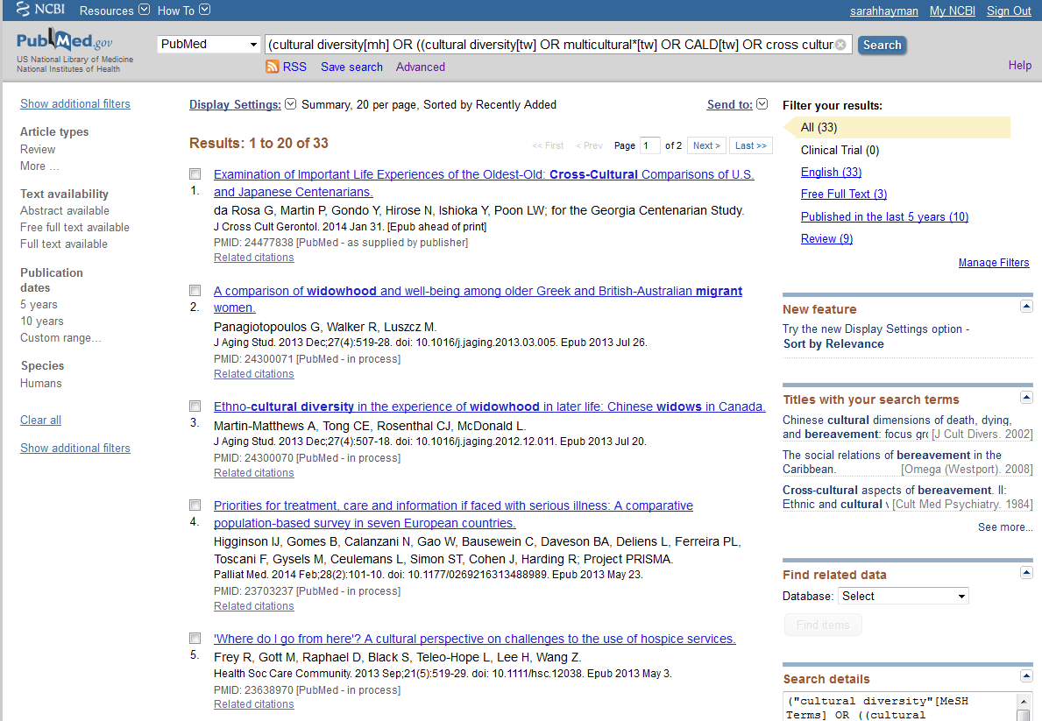
Notes:
This is the page of results from a search on everything, that is all references, for bereavement and multicultural issues.
It is a current search, with the most recent items at the top.

Slide 17
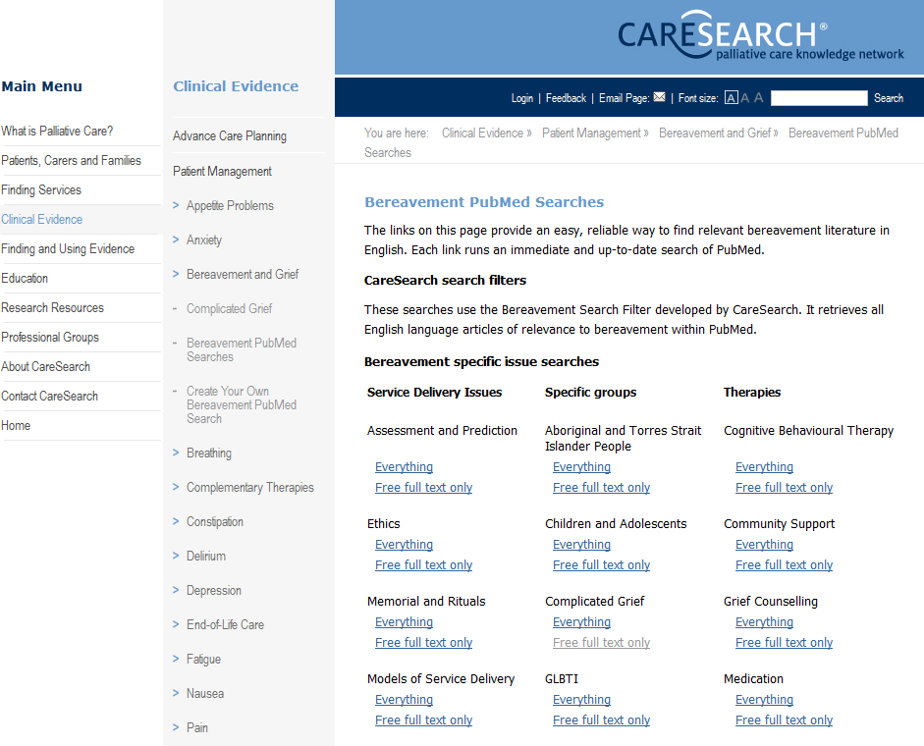
Notes:
This time we will look at Complicated Grief and we will choose Free Full Text only.
This means we are asking to see only those references which have the full article attached and available free. We don’t have to log on or belong to an institution to see the full text of these articles. It is a good way to get instant access to evidence.

Slide 18
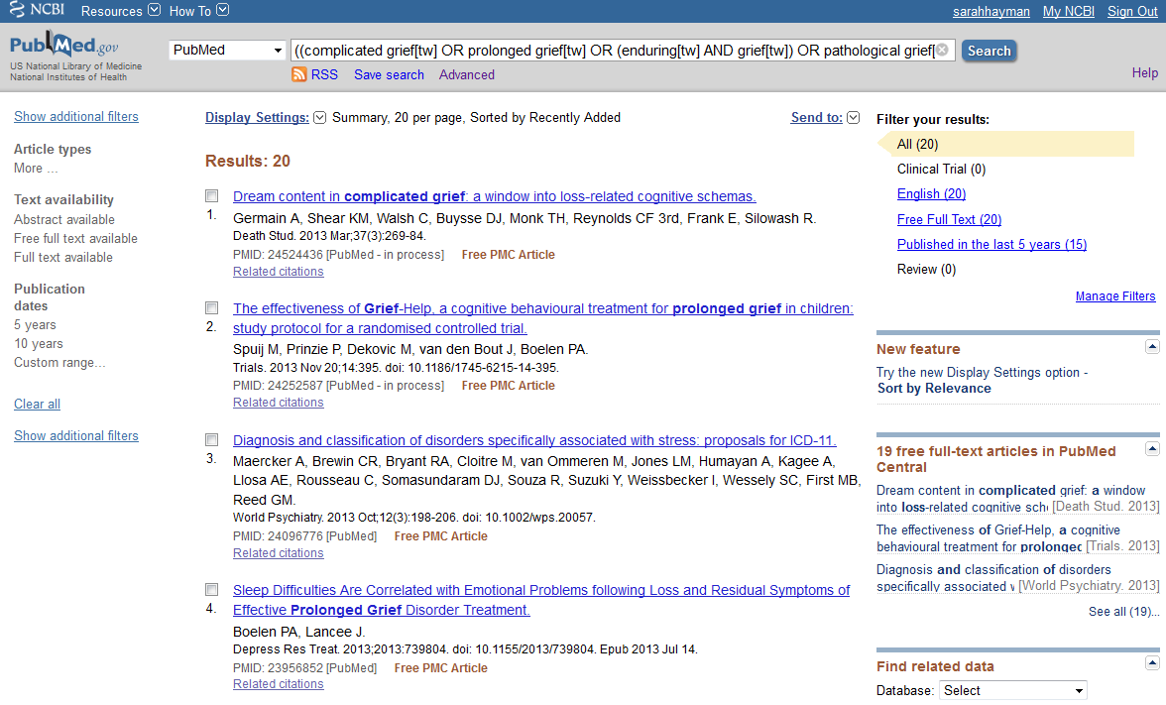
Notes:
This is the page of results from a search on references which have free full text available, for bereavement and complicated grief.
It is a current search, with the most recent items at the top.
The numbers are low because we have asked to see only those with free full text available; this limits the search. However we still have 20 recent items.
Notice that Complicated grief is also called Prolonged Grief – our topic search is designed to pick up all relevant items, regardless of the terminology used.

Slide 19
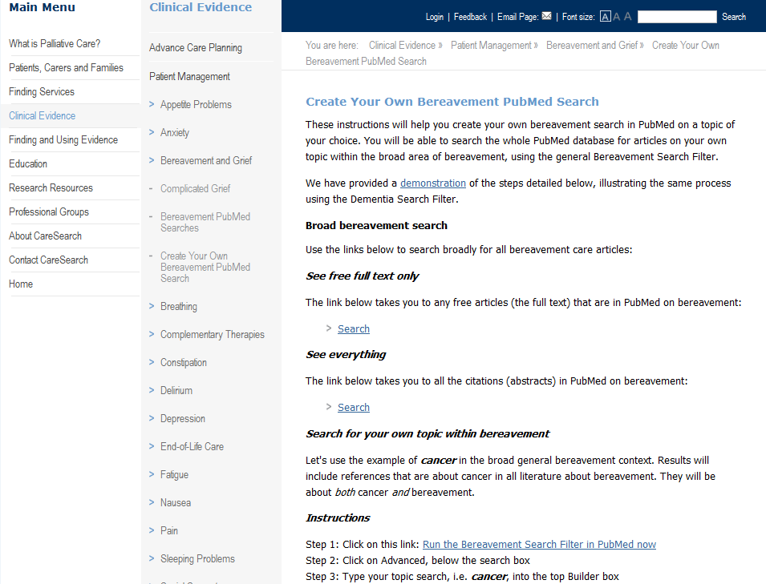
Create your own search
Notes:
Create your own topic search …
It is possible to combine the bereavement search filter with a topic of your own choice, if you are looking for something that is not in the list of topic searches we already provide. Wee provide instructions of how to do this in the section “Create your own Bereavement PubMed Search”. We take you step by step through an example of how to create a search for cancer and bereavement.

Slide 20
Conclusion
New Bereavement Search Filter
  Created by CareSearch and used on the website
Benefits for clinicians
  Topic searches are targeted to clinical practice
  Searches are fast and easy to use (no need to be an expert searcher)
  Searches are reliable
  Searches are free and open access (no need for logon or paid subscription)
  Barriers to using evidence in practice can be reduced
Notes:
So to conclude, I’ll focus again on the benefits for clinicians of the filters we create and provide on CareSearch:
We have a new search filter on CareSearch for bereavement. It is targeted to clinicians for use in practice, advised by experts involved in the development of the search filter and the topic searches. This filters can be used on its own or combined with our pre-written topic searches (or your own topic searches) to give easy to use and fast access to current evidence in these important areas for clinicians.
As we have explained, because these searches are built using a tested and validated search strategy with a known level of performance, the likelihood of high quality retrievals is much higher than if you were using an untested search or indeed a search engine such as Google.
Importantly, this is free and access is open to all. We know that not all people working in palliative care have access to the kind of commercial databases provided by universities and government organisations.
Our aim is to reduce and even remove some barriers to the use of evidence in practice by clinicians in palliative care. The searches can help those who don’t usually engage with evidence because it is all too hard – don’t need to be an expert searcher to use them and get good results.

Slide 21
Currently in development …
General Grief and Bereavement Search Filter
  This will be available on the Flinders Filters site later in 2014.
  Please register your interest with us if you would like to be informed when it is ready.

Slide 22

CareSearch would like to thank the many people
who contribute their time and expertise to the project, including members of the National Advisory Group and the Knowledge Network Management Group.
CareSearch is funded by the Australian Government Department of Health.
www.caresearch.com.au

