Slide 1
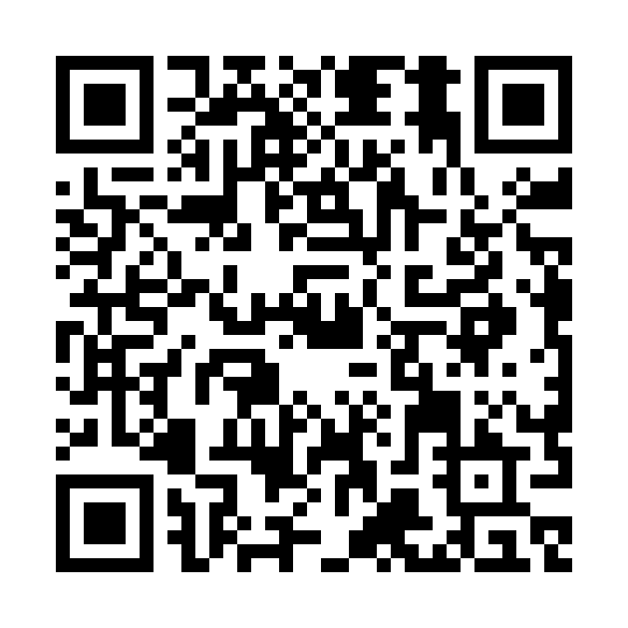
A grassroots approach to education in providing palliative care for older people
Working with the aged care sector, palliAGED has developed valued and practical resources. Despite an abundance of opportunities for palliative care education, what is needed is a stepped entry into education that will build the workforce and improve the care of older people. The palliAGED resources guide aged care staff on a continuum from understanding key principles, to in-house training, and responding to complex care needs at the end of life.
Authors: J Tieman, S Gravier, K Erny-Albrecht CareSearch, Flinders University
Other
Education
04
palliAGED Tip Sheets for Careworkers
03
05
Other
Education
SCAN FOR palliAGED Resources
palliAGED Introduction Modules for Aged Care
02
04
CareSearch Nurses Hub
Education for Careworkers
palliAGED Aged Care Journeys in Palliative Care for Careworkers
01
03
palliAGED Forms for Your Practice
02
palliAGED Tip Sheets for Nurses
Education for Nurses
palliAGED is the palliative care evidence and practice information resource for the Australian aged care sector. Using robust quality processes to ensure trustworthiness and relevance, it continuously evolves to meet the needs of the aged care workforce. Through partnerships with aged care services and representatives, palliAGED identifies and responds to sector needs.
01
palliAGED Introduction Modules for Aged Care
FIND OUT MORE AT
THE PALLIAGED BOOTH
OR ON OUR WEBSITE
palliaged.com.au

